Slide 1
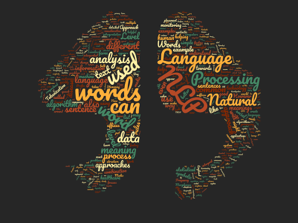

Amazon Review Classification Using NLP
By Dhanush Gowda

Slide 2
INDEX
PROBLEM STATEMENT
FEATURES
METHODOLOGY
RESULTS AND CONCLUSION

Slide 3

PROBLEM STATEMENT
In order to support Indian brands, 'Vocal for Local' campaign was started in India.
Emphasizing on a self-reliant, or ‘Aatmanirbhar’, India, the Indian government has asked that products not just be made in India, but also for the promotion of local brands, manufacturing, and supply chain.
The dataset comprises of 2500+ reviews of about 100+ Indian Products pertaining to categories like hair and skin care products, clothes, electronic gadgets, etc. from Amazon.
The purpose of this project is to classify ratings based on customer reviews of multiple products. And build an algorithm that automatically classifies ratings based on the model when any new data is updated.

Slide 4
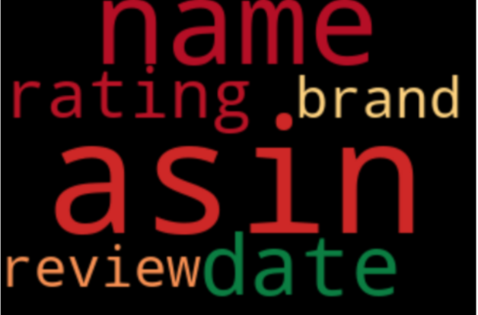
FEATURES
Asin : Amazon Standard Identification Number –
A unique id for each product on Amazon
Name : name of the product
Date : date on which review was posted
Rating : rating given to the product ( out of 5 )
Review : review given to the product

Slide 5
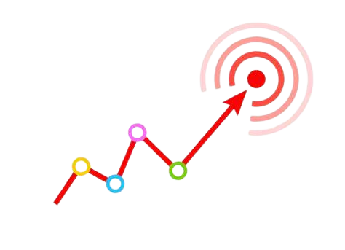
METHODOLOGY
EDA (Exploratory Data Analysis)
Data Preparation
Model building
Prediction

Slide 6
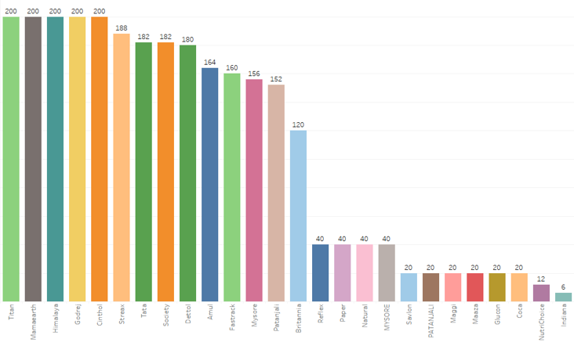
EDA (Exploratory Data Analysis)
Products Purchased
The given graph represents the Count of products Purchased from each Brands.
Titan, Himalaya, Mamaearth, Godrej are more popular.
Indiana, Nutrichoice, Patanjali are less popular when compared to Titan and Himalaya.

Slide 7
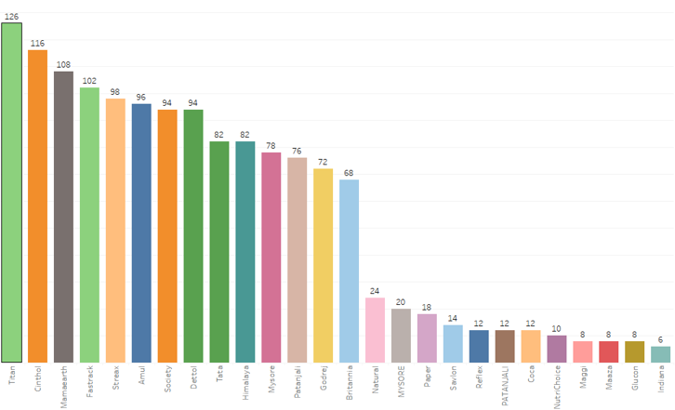
5-star Rated Brand Purchased
From the Graph we can say that “Titan” brand Product and many more has been Rated as 5 stars the most and is liked by many Customers.
And People are more Relying Mostly on “Titan” and Other products too. So, Seeing this in the Future People might be going for these products more than anything as per their requirements.

Slide 8
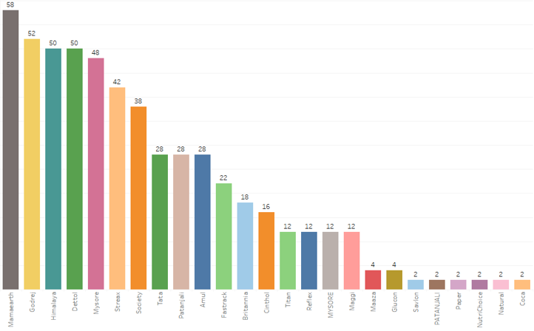
1-star Rated Brand Purchased
Here we can say that “Mama-earth” brand Products and many other brands has been Rated as 1 stars and is disliked by many Customers the most.
The Reason can be anything : what if the product was good but delivery was not within time or what if the product was a damaged one which can happen with anyone in one in 100s but can’t blame the brand. So, there can be Multiple Reason for Rating 1 star.
So, Seeing this in Future People might not go for these products and they might choose a different brand. Hence, these brands must focus on their Customers.

Slide 9

Selecting the Required Features for Model Building
So, Moving forward we just require those columns which can be used for Model building using NLP.
We will be considering Only the ‘Review’ column as our Independent Feature and ‘Rating’ as Dependent feature(Target Variable).
Our goal is to check whether the Review and Ratings are Directly Proportional to each other i.e., if we are building models by using some of the basic Algorithms and predicting that if there is a Rating given ,is the Review as Similar as it is to the Rating or not.

Slide 10
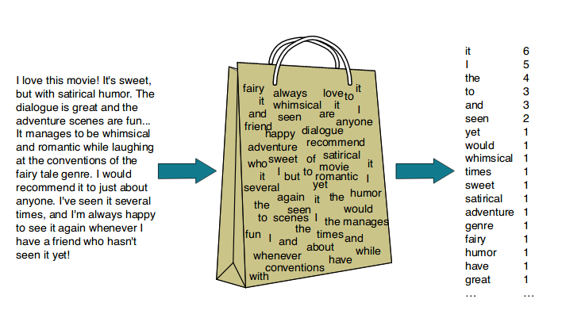

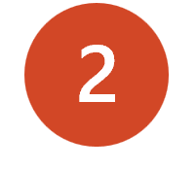
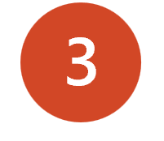

Word Embedding using NLP
Now we have to Clean and convert the Data in ‘Reviews’ from Word Embedding using NLP. Some of the Processes involved in converting Word Embedding are:
Tokenization
Stop words removal
Lowering the case
4
Lemmatization/Stemming
5
5Word to vector (BOW/TF-IDF)

Slide 11
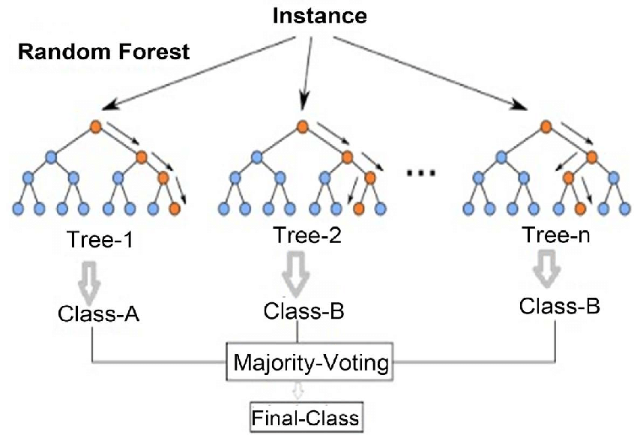
MODEL BUILDING
1.Using Bag of Words : Bag of words(bow) model is a way to preprocess text data for building machine learning model. Natural language processing(NLP) uses bow technique to convert text documents to machine understandable form. And trained the model using random forest classifier algorithm.
2.Using TF-IDF : Term frequency-inverse document frequency is a numerical statistic that intends to identify how relevant a word is to a document in a collection of documents. And again trained the model using random forest classifier algorithm.

Slide 12
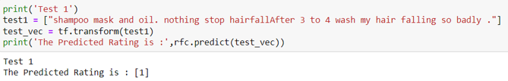

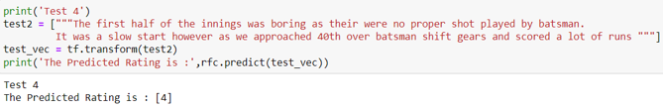
Final Test
As we have modelled our data we will now be testing it on random review to check how accurate is the rating. Try it:

Slide 13
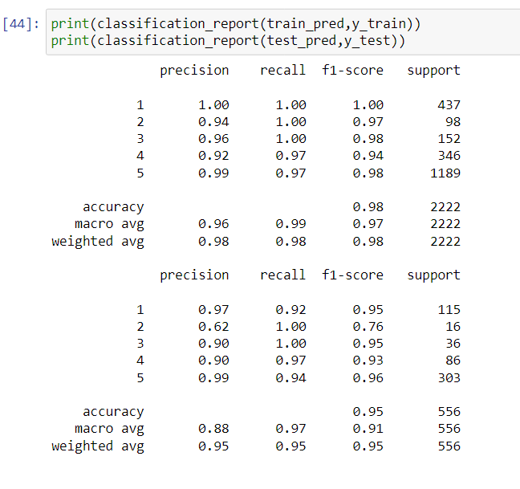
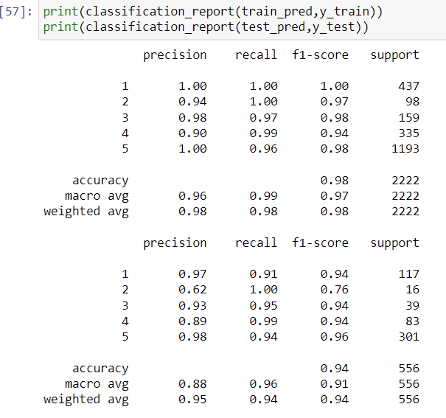
RESULTS
Here we get a very good Model using 'Bag Of words’ almost 98% accuracy but Still the Semantic meaning will be missing So, to overcome this problem we are further going for TF-IDF Technique.
So, by using TF-IDF the algorithm as Random Forest Classifier we are getting a very good model having a Good Precision ,Recall and Accuracy So, we can Conclude that the 'Review' and the 'Rating' are very much Similar provided by the Customers.

Slide 14

Final Conclusion
So, by using the algorithm as Random Forest Classifier and Technique as TF-IDF since it provides for Semantic Meaning to the data and Hence, we got a good model having a Good Precision, Recall and Accuracy of 98% Hence, we can Conclude that the 'Review' and the 'Rating' are Accurate as per the ratings Provided by the Customers on the Indian Products.
And In future if there is any new data updated will be automatically classified into the Major ratings as per the Model.
Since the model is able to classify the Reviews accurately it will be useful for the Organization /Companies to improve areas where they are lacking.

Slide 15


